Slide 1
Meibomian Gland Dysfunction (MGD)
subtitle

Slide 2
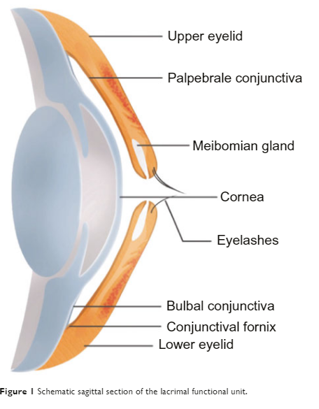
Let’s go to back to the beginning: Anterior eye¹
The cornea is the most fragile external structure of the body.
Healthy eyelid contains a lamellar structure with fine skin with conjunctiva on the inner surface.
Tear film forms a highly important layer between eyelid and surface of eye.
Eyelids protecting corneal surface
1. Benitez-del-Castillo, J.M., 2012. How to promote and preserve eyelid health. Clinical Ophthalmology, pp.1689-1698.
Notes:
Internal notes only:
1. Benitez-del-Castillo, J.M., 2012. How to promote and preserve eyelid health. Clinical Ophthalmology, pp.1689-1698.
The cornea is the most fragile external structure of the body and relies entirely on the eyelid and adjacent structures to maintain its patency
The healthy eyelid comprises a lamellar structure with fine skin on the outer surface and conjunctiva on the inner surface
The tear film can be considered a substructure of the eyelid and forms a highly important layer between the eyelid and the surface of the eye and between the exterior environment and the eye surface

Slide 3
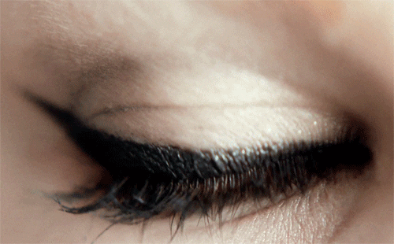
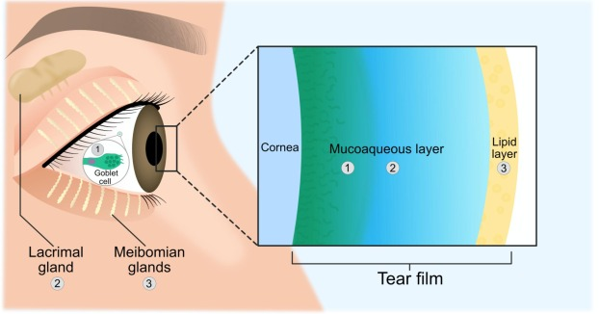
What’s behind the lids? The tear film^{1,2}
Older research suggests a three distinct layer tear film: lipid layer, aqueous layer, mucin layer.
New research now suggest two layers - the lipid layer overlying the mucoaqueous layer.
Adapted from Magno et al., 2022²
1. Nelson JD, Craig JP, EK Akpek, et al. TFOS DEWS II introduction. Ocul Surf. 2017;15(3):269-75. 2. Magno, M.S., Olafsson, J., Beining, M., Moschowits, E., Lagali, N., Wolffsohn, J.S., Craig, J.P., Vehof, J., Dartt, D.A. and Utheim, T.P., 2022. Hot towels: The bedrock of Meibomian gland dysfunction treatment–A review. Contact Lens and Anterior Eye, p.101775.
Notes:
Internal:
1. Nelson JD, Craig JP, EK Akpek, et al. TFOS DEWS II introduction. Ocul Surf. 2017;15(3):269-75.
DED implies major changes to the tear film structure and function, which are associated with this disease. Historically, the tear film has been viewed as a 3-layer “sandwich” composed of distinct lipid, aqueous and mucin layers. Evidence continues to support the more contemporary two-phase model of the tear film, with a lipid layer overlying a mucoaqueous phase

Slide 4
What is the function of the tear film?¹
Smooth surface for refraction of light
Lubrication of the ocular surface
Supplying the avascular cornea with nutrients
Removing foreign materials from the cornea and conjunctiva
Protecting the eye from pathogens
1. Rojas, B.R., OD (2023) Understanding the tear film. https://www.reviewofcontactlenses.com/article/understanding-the-tear-film
Notes:
Internal
Rojas, B.R., OD (2023) Understanding the tear film. https://www.reviewofcontactlenses.com/article/understanding-the-tear-film
There are several functions of the tear film, including maintaining a smooth surface for refraction of light, lubrication of the ocular surface, supplying the avascular cornea with nutrients, removing foreign materials from the cornea and conjunctiva, and protecting the eye from pathogens.⁴

Slide 5
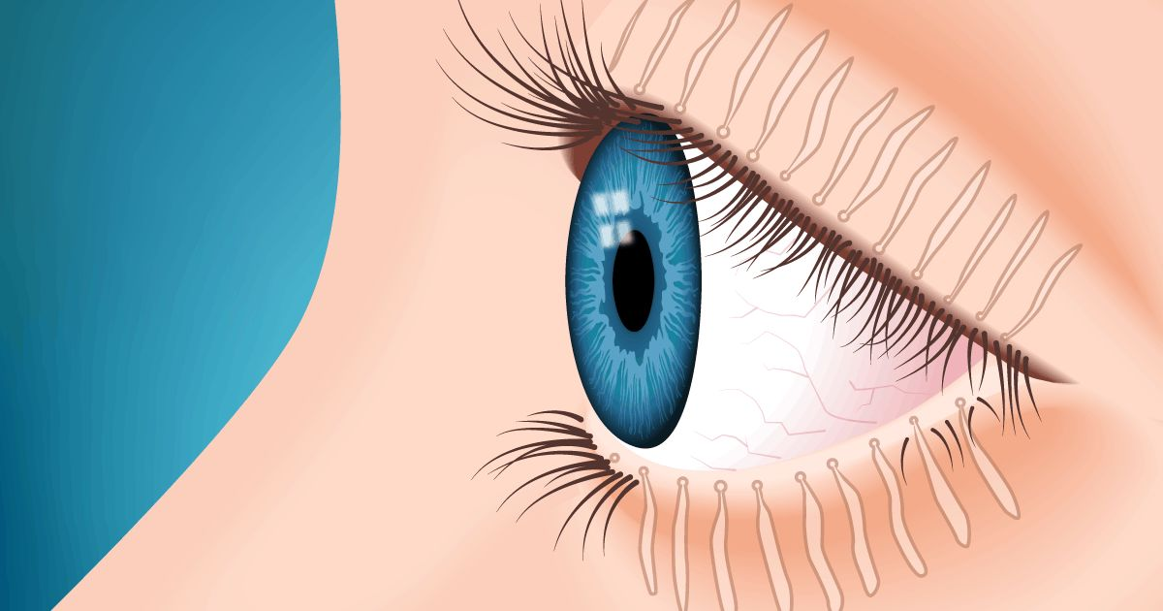
Meibomian Gland Dysfunction (MGD) – what is it?¹
Meibomian glands – large sebaceous glands in tarsal plates of the eyelids.
The glands synthesize and secrete the lipid layer of the tear film (meibum) delivered at the upper and lower eyelid margins.
Meibomian glands are densely innervated.
1. Nichols, K.K., Foulks, G.N., Bron, A.J., Glasgow, B.J., Dogru, M., Tsubota, K., Lemp, M.A. and Sullivan, D.A., 2011. The international workshop on meibomian gland dysfunction: executive summary. Investigative ophthalmology & visual science, 52(4), pp.1922-1929.
Notes:
Internal notes
Eberhardt, M. and Rammohan, G., 2017. Blepharitis.
Blepharitis is an ophthalmologic condition characterized by an inflammation of the eyelid margins.
It can be acute or chronic with chronic being the more common form.
It usually presents with recurrent symptoms that may vary over time and involve both eyes

Slide 6
MGD – what is it?¹
“Meibomian gland dysfunction (MGD) is a chronic, diffuse abnormality of the meibomian glands, commonly characterized by terminal duct obstruction and/or qualitative/quantitative changes in the glandular secretion. It may result in alteration of the tear film, symptoms of eye irritation, clinically apparent inflammation, and ocular surface disease.”
Classification of MGD into two major categories:
Low-delivery state of gland secretion
High-delivery state of gland secretion
1. Nichols, K.K., Foulks, G.N., Bron, A.J., Glasgow, B.J., Dogru, M., Tsubota, K., Lemp, M.A. and Sullivan, D.A., 2011. The international workshop on meibomian gland dysfunction: executive summary. Investigative ophthalmology & visual science, 52(4), pp.1922-1929.
Notes:
Internal notes
Eberhardt, M. and Rammohan, G., 2017. Blepharitis.
Blepharitis is an ophthalmologic condition characterized by an inflammation of the eyelid margins.
It can be acute or chronic with chronic being the more common form.
It usually presents with recurrent symptoms that may vary over time and involve both eyes

Slide 7
Symptoms of MGD^{1,2}
Burning/gritty sensation
Sore, red, inflamed eyelids
Contact lens discomfort
Asymptomatic
Fluctuations in vision
Watery eyes
Photophobia
1. Gurnani, B. and Kaur, K., 2022. Meibomian Gland Disease. In StatPearls [Internet]. StatPearls Publishing. 2. Suzuki, T., Kitazawa, K., Cho, Y., Yoshida, M., Okumura, T., Sato, A. and Kinoshita, S., 2022. Alteration in meibum lipid composition and subjective symptoms due to aging and meibomian gland dysfunction. The Ocular Surface, 26, pp.310-317.
Notes:
Internal notes
College of optom
Blepharitis may be asymptomatic. However, when present, the symptoms of anterior blepharitis, posterior blepharitis and mixed anterior and posterior blepharitis are similar:
ocular discomfort, soreness, burning, itching
mild photophobia
symptoms of dry eye including blurred vision and contact lens intolerance.

Slide 8
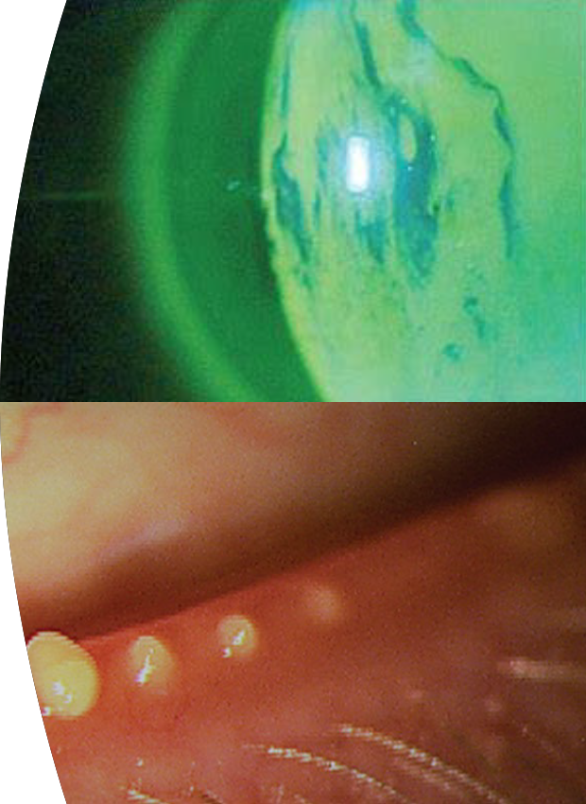
Signs of MGD¹
Thick and/or opaque secretion at meibomian gland orifices, making it difficult or impossible to express oil by finger pressure
Foam in the lower tear film meniscus (due to excess tear film lipid)
Plugging of duct orifices with abnormal lipid leading to dilatation of glands and formation of microliths and chalazia
Conjunctival hyperaemia
Evaporative tear deficiency, unstable pre-corneal tear film
Secondary signs include punctate epithelial erosion over lower third of cornea; marginal keratitis; scarring; neovascularisation and pannus; mild papillary conjunctivitis.
1. College of Optometrist 2024. Clinical Management Guidelines of Blepharitis (Lid margin disease). Available at: https://www.college-optometrists.org/clinical-guidance/clinical-management-guidelines/blepharitis_lidmargindisease Accessed on [June 2024]

Slide 9
Diagnostic tests for MGD¹
Symptom questionnaire
Measuring blink rate and calculation of the blink interval
Measurement of the lower tear meniscus height
Measuring tear osmolarity
Instillation of fluorescein and measuring tear break up time
Grading of corneal and conjunctival fluorescein staining
Expression of meibum – quantification of meibum expressibility and quality
Meibography – quantification of dropout
1. Nichols, K.K., Foulks, G.N., Bron, A.J., Glasgow, B.J., Dogru, M., Tsubota, K., Lemp, M.A. and Sullivan, D.A., 2011. The international workshop on meibomian gland dysfunction: executive summary. Investigative ophthalmology & visual science, 52(4), pp.1922-1929.
Notes:
Internal
College of optometrists
Predisposing factors
Seborrhoeic dermatitis (for example, of the scalp). Ocular rosacea (a cause of posterior blepharitis).
Demidicosis
Demodex folliculorum is an ectoparasite that occurs normally in the lash follicles
Demodex brevis, also an ectoparasite, is found in meibomian glands.
Long-term contact lens wear.

Slide 10
Cataract surgery and MGD¹
Cataract surgery can worsen MGD during the postoperative period to result in increased ocular discomfort, and decreased vision and patient satisfaction.
Lid hygiene before/after cataract surgery improved postoperative subjective symptoms and prevented postoperative exacerbation of anterior blepharitis, meibomian gland expressibility, and meibomian gland secretion score.
Preservative-free disposable sterile eyelid wipes prevent blepharitis and MGD exacerbation after cataract surgery.
1. Eom, Y., Na, K.S., Hwang, H.S., Cho, K.J., Chung, T.Y., Jun, R.M., Ko, B.Y., Chun, Y.S., Kim, H.S. and Song, J.S., 2020. Clinical efficacy of eyelid hygiene in blepharitis and meibomian gland dysfunction after cataract surgery: a randomized controlled pilot trial. Scientific reports, 10(1), pp.1-11.
Notes:
Internal
Eom, Y., Na, K.S., Hwang, H.S., Cho, K.J., Chung, T.Y., Jun, R.M., Ko, B.Y., Chun, Y.S., Kim, H.S. and Song, J.S., 2020. Clinical efficacy of eyelid hygiene in blepharitis and meibomian gland dysfunction after cataract surgery: a randomized controlled pilot trial. Scientific reports, 10(1), pp.1-11.
Cataract surgery can worsen blepharitis and meibomian gland function during the postoperative period to result in increased ocular discomfort and decreased vision and patient satisfaction.
Second, subbasal corneal nerve fibers are reduced and corneal sensitivity is decreased after clear corneal incision cataract surgery^{24,25}. Recovery of subbasal corneal nerve fibers takes about 8 months, and recovery of corneal sensation takes about 1 to 3 months^{24,25,26}. Decreased corneal sensitivity causes decreased blinking rate²⁷ and incomplete blinking, which might contribute to MGD progression because meibum is delivered from meibomian glands by squeezing of the orbicularis oculi and Riolan muscles^{28,29,30,31}. Third, the use of an eyelid speculum may induce eyelid dysfunction in early postoperative periods^{32,33} to result in inappropriate blinking and squeezing force to deliver meibum from meibomian glands^{9,12}. Fourth, increased ocular surface inflammation after cataract surgery may influence eyelid margins and meibomian gland function^{10,12}.
Lid hygiene before/after cataract surgery improved postoperative subjective symptoms and prevented postoperative exacerbation of anterior blepharitis, meibomian gland expressibility, and meibomian gland secretion score. Thus, perioperative eyelid hygiene using preservative-free disposable sterile eyelid wipes is needed to improve subjective symptoms and prevent blepharitis and MGD exacerbation after cataract surgery.

Slide 11
How do we treat blepharitis?¹
Management of Dry Eye Disease, if also present.
Make patients aware of chronic nature of condition and the need of on-going treatment.
Daily lid hygiene
Lid cleansing measure to wipe away bacteria and deposits from lid margins.
Some key things to remember:
Remove all eye makeup before bed
No sharing skincare products
No sharing facecloths or towels
Washing eyelids daily
Seek medical advice if worsening
1. College of Optometrist 2024. Clinical Management Guidelines of Blepharitis (Lid margin disease). Available at: https://www.college-optometrists.org/clinical-guidance/clinical-management-guidelines/blepharitis_lidmargindisease Accessed on [June 2024]

Slide 12
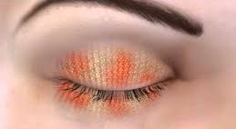
What is so important about HEAT?^{1,2}
HEAT
We want to increase the quality of the meibum…
Current thinking:
5 minutes* of heat @ 40ºC increases tear film lipid layer thickness by 80% in MGD patients¹
Remember to recommend gentle massaging to release the meibum
1. Olson Korb Greiner. Increase in tear film lipid layer thickness following treatment with warm compresses in patients with meibomian gland dysfunction. Eye Contact lens. 2003;29:96-99 DEWS II 2. Benitez-del-Castillo, J.M., Dana, R., Deng, S.X., Dong, P.N., Geerling, G., FEBO, M., Hida, R.Y., Liu, Y., Seo, K.Y., Tauber, J. and Wakamatsu, T.H., 2017. TFOS DEWS II Management and Therapy Report. Ocular Surface, 30, p.580e634.
Notes:
Current thinking
5 minutes of heat @40 degrees increases tear film lipid layer thickness by 80% in MGD patients
Olson Korb Greiner. Increase in tear film lipid layer thickness following treatment with warm compresses in patients with meibomian gland dysfunction. Eye Contact lens. 2003;29:96-99
DEWS II

Slide 13
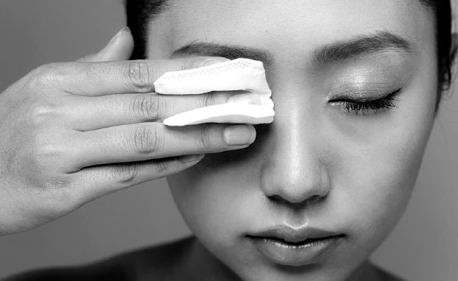
What is so important about CLEANSE?¹
It is important to make sure all the debris/dirt has been cleaned from eyelashes...
CLEANSE
Choose an option to suit the patient
Preservative free
1. Nichols, K.K., Foulks, G.N., Bron, A.J., Glasgow, B.J., Dogru, M., Tsubota, K., Lemp, M.A. and Sullivan, D.A., 2011. The international workshop on meibomian gland dysfunction: executive summary. Investigative ophthalmology & visual science, 52(4), pp.1922-1929.
Notes:
DEWS II

Slide 14
What is so important about HYDRATE?¹
Addition of hydration/lubrication is important to restore the homeostasis to the tear film...
HYDRATE
Preservative free
1. Nichols, K.K., Foulks, G.N., Bron, A.J., Glasgow, B.J., Dogru, M., Tsubota, K., Lemp, M.A. and Sullivan, D.A., 2011. The international workshop on meibomian gland dysfunction: executive summary. Investigative ophthalmology & visual science, 52(4), pp.1922-1929.
Notes:
DEWS II

Slide 15
QUESTIONS

