Slide 1
Dry Eye
subtitle

Slide 2
What is Dry Eye Disease (DED)?¹
“Dry eye is a multifactorial disease of the ocular surface characterised by a loss of homeostasis of the tear film, and accompanied by ocular symptoms, in which tear film instability and hyperosmolarity, ocular surface inflammation and damage, and neurosensory abnormalities play etiological roles.”
1. Craig, J.P., Nelson, J.D., Azar, D.T., Belmonte, C., Bron, A.J., Chauhan, S.K., de Paiva, C.S., Gomes, J.A., Hammitt, K.M., Jones, L. and Nichols, J.J., 2017. TFOS DEWS II report executive summary. The ocular surface, 15(4), pp.802-812.

Slide 3
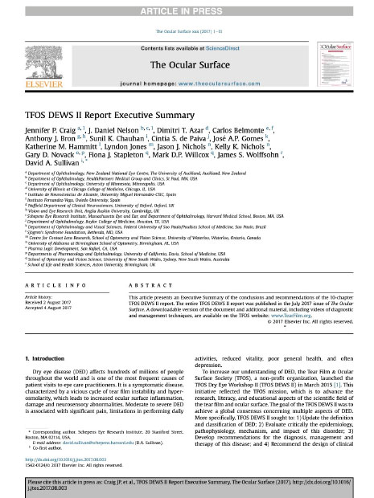
Dry Eye Workshop II (DEWS II)¹
To increase understanding of dry eye the Tear Film and Ocular Society launched DEWS II.
2-year effort for 12 sub-committees
150 clinical and basic research specialists
From 23 countries
1. Craig, J.P., Nelson, J.D., Azar, D.T., Belmonte, C., Bron, A.J., Chauhan, S.K., de Paiva, C.S., Gomes, J.A., Hammitt, K.M., Jones, L. and Nichols, J.J., 2017. TFOS DEWS II report executive summary. The ocular surface, 15(4), pp.802-812.

Slide 4
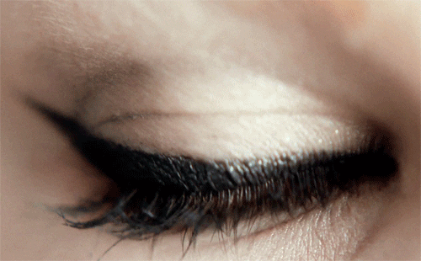
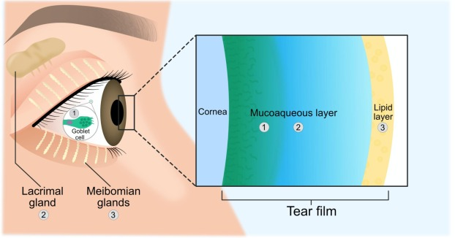
What’s behind the lids? The tear film
Older research suggests a three distinct layer tear film: lipid layer, aqueous layer, mucin layer¹.
New research now suggest two layers - the lipid layer overlying the mucoaqueous layer¹.
Adapted from Magno et al., 2022²
1. Nelson JD, Craig JP, EK Akpek, et al. TFOS DEWS II introduction. Ocul Surf. 2017;15(3):269-75. 2. Magno, M.S., Olafsson, J., Beining, M., Moschowits, E., Lagali, N., Wolffsohn, J.S., Craig, J.P., Vehof, J., Dartt, D.A. and Utheim, T.P., 2022. Hot towels: The bedrock of Meibomian gland dysfunction treatment–A review. Contact Lens and Anterior Eye, p.101775.
Notes:
Internal:
1. Nelson JD, Craig JP, EK Akpek, et al. TFOS DEWS II introduction. Ocul Surf. 2017;15(3):269-75.
DED implies major changes to the tear film structure and function, which are associated with this disease. Historically, the tear film has been viewed as a 3-layer “sandwich” composed of distinct lipid, aqueous and mucin layers. Evidence continues to support the more contemporary two-phase model of the tear film, with a lipid layer overlying a mucoaqueous phase

Slide 5
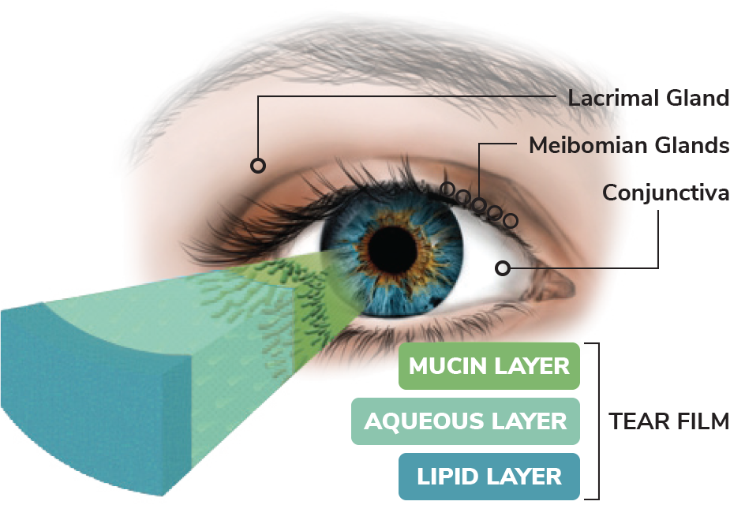
What is the function of the tear film?¹
Approx
65%
of the optical power of the eye is made up by the tear film¹.
1. Pflugfelder, S.C., 2011. Tear dysfunction and the cornea: LXVIII Edward Jackson memorial lecture. American journal of ophthalmology, 152(6), pp.900-909.
Notes:
Internal
Rojas, B.R., OD (2023) Understanding the tear film. https://www.reviewofcontactlenses.com/article/understanding-the-tear-film
There are several functions of the tear film, including maintaining a smooth surface for refraction of light, lubrication of the ocular surface, supplying the avascular cornea with nutrients, removing foreign materials from the cornea and conjunctiva, and protecting the eye from pathogens.⁴

Slide 6
What is the function of the tear film?¹
Smooth surface for refraction of light
Lubrication of the ocular surface
Supplying the avascular cornea with nutrients
Removing foreign materials from the cornea and conjunctiva
Protecting the eye from pathogens
1. Rojas, B.R., OD (2023) Understanding the tear film. https://www.reviewofcontactlenses.com/article/understanding-the-tear-film
Notes:
Internal
Rojas, B.R., OD (2023) Understanding the tear film. https://www.reviewofcontactlenses.com/article/understanding-the-tear-film
There are several functions of the tear film, including maintaining a smooth surface for refraction of light, lubrication of the ocular surface, supplying the avascular cornea with nutrients, removing foreign materials from the cornea and conjunctiva, and protecting the eye from pathogens.⁴

Slide 7
Why is DED a big problem for patients?
Two Large Studies: 78,165 participants (19-94 years, 5.2% female) from Dutch population-based¹ and 89,022 participants (18–96 years, 59% female) from Dutch population-based².
Compared to macular degeneration, glaucoma, retinal detachment, and allergic conjunctivitis, DED presented similar or higher risks for compromised score on all Vision-related -QoL domains².
Driving
Colour Vision
Worrying about eyesight
Ocular pain
Undiagnosed DED subjects had a significantly increased risk of low mental health related QoL with increasing dry eye symptoms compared to diagnosed subjects¹.
1. Morthen, M.K., Magno, M.S., Utheim, T.P., Snieder, H., Hammond, C.J. and Vehof, J., 2021. The physical and mental burden of dry eye disease: a large population-based study investigating the relationship with health-related quality of life and its determinants. The Ocular Surface, 21, pp.107-117. 2. Morthen, M.K., Magno, M.S., Utheim, T.P., Snieder, H., Jansonius, N., Hammond, C.J. and Vehof, J., 2022. The vision-related burden of dry eye. The Ocular Surface, 23, pp.207-215.

Slide 8
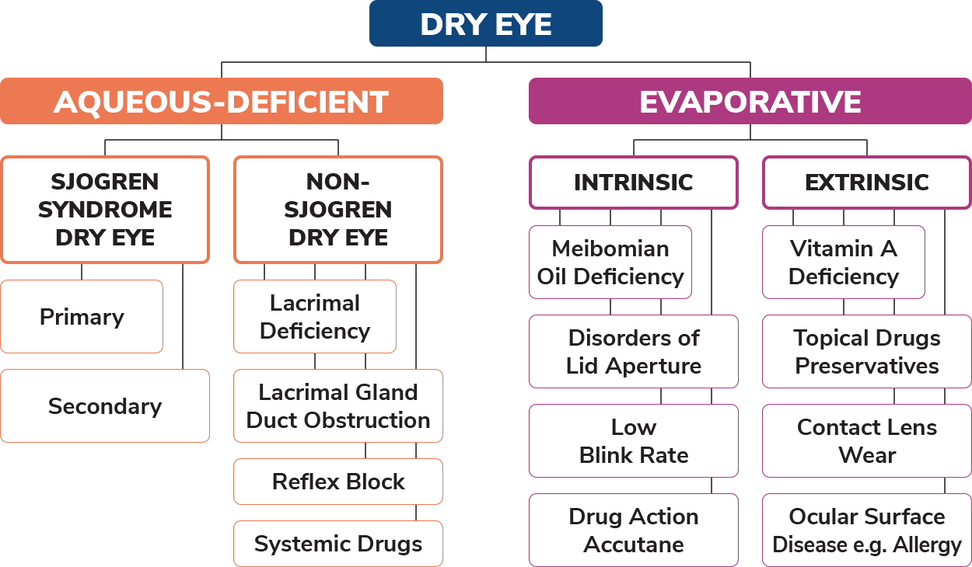
Classifying Dry Eye^{1,2}
“Diagnosis precedes therapy”, clinicians must make their best efforts to identify the degree to which Aqueous Deficient, evaporate or other ocular surface conditions are contributing to the patient’s presentation².
1. Foulks, G.N., Lemp, M., Jester, J., Sutphin, J., Murube, J. and Novack, G.J.O.S., 2007. Report of the international dry eye workshop (DEWS). Ocul Surf, 5(2), pp.65-204. 2. Craig, J.P., Nelson, J.D., Azar, D.T., Belmonte, C., Bron, A.J., Chauhan, S.K., de Paiva, C.S., Gomes, J.A., Hammitt, K.M., Jones, L. and Nichols, J.J., 2017. TFOS DEWS II report executive summary. The ocular surface, 15(4), pp.802-812.
Notes:
Internal
Rojas, B.R., OD (2023) Understanding the tear film. https://www.reviewofcontactlenses.com/article/understanding-the-tear-film
There are several functions of the tear film, including maintaining a smooth surface for refraction of light, lubrication of the ocular surface, supplying the avascular cornea with nutrients, removing foreign materials from the cornea and conjunctiva, and protecting the eye from pathogens.⁴

Slide 9
Viscous Cycle of Dry Eye Disease¹
Tear film instability
Excess evaporation from ocular surface
Increased osmolarity of tear film
Damage to surface cells
Inflammation of ocular surface
Loss of microvilli, glycocalyx & goblet cells
No matter how the Dry Eye is initiated it enters a common pathway where tear hyperosmolarity and a chain of inflammatory events creates a viscous cycle of Dry Eye Disease.
1. Bron, A.J., de Paiva, C.S., Chauhan, S.K., Bonini, S., Gabison, E.E., Jain, S., Knop, E., Markoulli, M., Ogawa, Y., Perez, V. and Uchino, Y., 2017. Tfos dews ii pathophysiology report. The ocular surface, 15(3), pp.438-510.
Notes:
Internal
Rojas, B.R., OD (2023) Understanding the tear film. https://www.reviewofcontactlenses.com/article/understanding-the-tear-film
There are several functions of the tear film, including maintaining a smooth surface for refraction of light, lubrication of the ocular surface, supplying the avascular cornea with nutrients, removing foreign materials from the cornea and conjunctiva, and protecting the eye from pathogens.⁴

Slide 10
What are some of the causes of Dry Eye?¹
Age
Sex
Meibomian gland dysfunction
Race
Refractive surgery
Sjogren syndrome
Contact lens use
Diabetes
Environmental exposures
Visual display use
1. Stapleton, F., Alves, M., Bunya, V.Y., Jalbert, I., Lekhanont, K., Malet, F., Na, K.S., Schaumberg, D., Uchino, M., Vehof, J. and Viso, E., 2017. Tfos dews ii epidemiology report. The ocular surface, 15(3), pp.334-365.

Slide 11
Medications and Dry Eye
Classification of medications:
Systemic
Topical
Systemic drugs may cause dry eye secondary to¹:
Decreased tear production
Altered nerve input
Reflex secretion
Inflammatory effects on secretory glands
Direct irritation effects through secretion into the tears
Topical drugs may cause dry eye by³:
Exerting allergic, toxic and/or immuno-inflammatory affects
Reducing aqueous secretion
Damaging goblet cells, the conjunctival and corneal epithelia, corneal nerves through neurotoxic effects
Among the 100 top selling medications – 22 of them possibly cause dry eye¹.
Up to 62% of dry eye in the population can be attributed to drying².
1. Gomes, J.A.P., Azar, D.T., Baudouin, C. et al TFOS Dews Ii Iatrogenic report. The ocular surface, 15(3), pp.511-538. 2. Schein, O.D., Hochberg, M.C., Munoz, B. et al Archives of internal medicine, 159(12), pp.1359-1363. 3. Gomes, J.A.P., Azar, D.T., Baudouin, C., Efron, N., Hirayama, M., Horwath-Winter, J., Kim, T., Mehta, J.S., Messmer, E.M., Pepose, J.S. and Sangwan, V.S., 2017. Tfos dews ii iatrogenic report. The ocular surface, 15(3), pp.511-538.

Slide 12
Patient Questionnaires
For dry eye assessments, subjective symptoms and their effects on Health Related QoL can be assessed using questionnaires and clinical examination¹.
The OSDI (ocular surface disease index) is a 12-item questionnaire to provide rapid assessment of the symptoms of ocular irritation consistent with dry eye disease and their impact on vision related functioning².
The DEQ-5 is a 5 item Dry Eye Questionnaire and is recommended due to its discriminative ability³.
The view of the TFOS committee was to use the OSDI due to its strong establishment in the field or the DEQ-5 due to its short length and discriminative ability³.
1. Özcura, F., Aydin, S. and Helvaci, M.R., 2007. Ocular surface disease index for the diagnosis of dry eye syndrome. Ocular immunology and inflammation, 15(5), pp.389-393. 2. Grubbs Jr, J.R., Tolleson-Rinehart, S., Huynh, K. and Davis, R.M., 2014. A review of quality-of-life measures in dry eye questionnaires. Cornea, 33(2), pp.215-218. 3. Wolffsohn, J.S., Arita, R., Chalmers, R., Djalilian, A., Dogru, M., Dumbleton, K., Gupta, P.K., Karpecki, P., Lazreg, S., Pult, H. and Sullivan, B.D., 2017. TFOS DEWS II diagnostic methodology report. The ocular surface, 15(3), pp.539-574.

Slide 13
How do we manage Dry Eye Disease?
Modification of local environment¹:
Avoid environmental pollutants
Avoid overheated and air-conditioned environments
Consider air humidification
Digital device use (improve blinking, optimise the work environment and encourage regularly breaks)
Some key things to remember:
Remove all eye makeup before bed
No sharing skincare products
No sharing facecloths or towels
Washing eyelids daily
Seek medical advice if worsening
1. College of Optometrists 2024. Clinical Management Guidelines of Dry Eye (Keratoconjunctivitis Sicca, KCS). Available at: www.college-optometrists.org/clinical-guidance/clinical-management-guidelines/dryeye_keratoconjunctivitissicca_kcs Accessed on [July 2024}

Slide 14
Management of Dry Eye¹
A regime including lubricants, lid hygiene and heat applied to the eyes for the management of dry eye disease and related eye conditions.
Preservative free eye drops have shown greater effectiveness than preserved drops in decreasing inflammation on the ocular surface and increasing the antioxidant contents in tears of patients with DED.
1. Benitez-del-Castillo, J.M., Dana, R., Deng, S.X., Dong, P.N., Geerling, G., FEBO, M., Hida, R.Y., Liu, Y., Seo, K.Y., Tauber, J. and Wakamatsu, T.H., 2017. TFOS DEWS II Management and Therapy Report. Ocular Surface, 30, p.580e634.

Slide 15
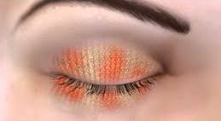
What is so important about HEAT?^{1,2}
HEAT
Can increase the lipid layer thickness…
Current thinking:
5 minutes* of heat @ 40ºC increases tear film lipid layer thickness by 80% in MGD patients¹
Remember to recommend gentle massaging to release the meibum
1. Olson Korb Greiner. Increase in tear film lipid layer thickness following treatment with warm compresses in patients with meibomian gland dysfunction. Eye Contact lens. 2003;29:96-99 DEWS II 2. Benitez-del-Castillo, J.M., Dana, R., Deng, S.X., Dong, P.N., Geerling, G., FEBO, M., Hida, R.Y., Liu, Y., Seo, K.Y., Tauber, J. and Wakamatsu, T.H., 2017. TFOS DEWS II Management and Therapy Report. Ocular Surface, 30, p.580e634.
Notes:
Current thinking
5 minutes of heat @40 degrees increases tear film lipid layer thickness by 80% in MGD patients
Olson Korb Greiner. Increase in tear film lipid layer thickness following treatment with warm compresses in patients with meibomian gland dysfunction. Eye Contact lens. 2003;29:96-99
Recommended 10 minutes etc
DEWS II

Slide 16
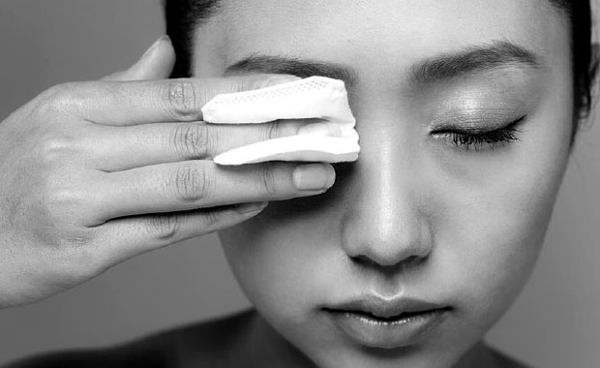
What is so important about CLEANSE?¹
CLEANSE
It is important to make sure all the debris/dirt has been cleaned from eyelashes...
Choose an option to suit the patient
Preservative free
1. Benitez-del-Castillo, J.M., Dana, R., Deng, S.X., Dong, P.N., Geerling, G., FEBO, M., Hida, R.Y., Liu, Y., Seo, K.Y., Tauber, J. and Wakamatsu, T.H., 2017. TFOS DEWS II Management and Therapy Report. Ocular Surface, 30, p.580e634.
Notes:
DEWS II

Slide 17
What is so important about HYDRATE?¹
Addition of hydration/lubrication is important to restore the homeostasis to the tear film...
HYDRATE
Preservative free
1. Benitez-del-Castillo, J.M., Dana, R., Deng, S.X., Dong, P.N., Geerling, G., FEBO, M., Hida, R.Y., Liu, Y., Seo, K.Y., Tauber, J. and Wakamatsu, T.H., 2017. TFOS DEWS II Management and Therapy Report. Ocular Surface, 30, p.580e634.
Notes:
DEWS II

Slide 18
QUESTIONS

