Slide 1
Dry Eye and Contact Lenses
Subtitle

Slide 2
What is Dry Eye Disease (DED)?¹
“Dry eye is a multifactorial disease of the ocular surface characterised by a loss of homeostasis of the tear film, and accompanied by ocular symptoms, in which tear film instability and hyperosmolarity, ocular surface inflammation and damage, and neurosensory abnormalities play etiological roles.”
1. Craig, J.P., Nelson, J.D., Azar, D.T., Belmonte, C., Bron, A.J., Chauhan, S.K., de Paiva, C.S., Gomes, J.A., Hammitt, K.M., Jones, L. and Nichols, J.J., 2017. TFOS DEWS II report executive summary. The ocular surface, 15(4), pp.802-812.

Slide 3
Contact Lens Wear¹
Worn primarily for cosmesis.
CL wearers mainly young and female and 86% of lenses fitted in 2021 are single vision.
In 2021 nearly 50% of all contact lenses prescribed worldwide were daily disposables.
Silicone hydrogel account for 74% of all soft contact lens fits worldwide in 2021.
1. Jones, L., Efron, N., Bandamwar, K., Barnett, M., Jacobs, D.S., Jalbert, I., Pult, H., Rhee, M.K., Sheardown, H., Shovlin, J.P. and Stahl, U., 2023. TFOS Lifestyle: impact of contact lenses on the ocular surface. The Ocular Surface.

Slide 4
Factors that determine CL wear success¹
Quality of vision
Ocular comfort
Utility of lens wear
Convenience
Contact lens discontinuation rates are at around 25% over a 2–3-year period.
1. Jones, L., Efron, N., Bandamwar, K., Barnett, M., Jacobs, D.S., Jalbert, I., Pult, H., Rhee, M.K., Sheardown, H., Shovlin, J.P. and Stahl, U., 2023. TFOS Lifestyle: impact of contact lenses on the ocular surface. The Ocular Surface.

Slide 5
Contact lens discomfort¹
“Contact lens discomfort is a condition characterized by episodic or persistent adverse ocular sensations related to lens wear, either with or without visual disturbance, resulting from reduced compatibility between the contact lens and the ocular environment, which can lead to decreased wearing time and discontinuation of contact lens wear”
1. Nichols KK, Redfern RL, Jacob JT, Nelson JD, Fonn D, Forstot SL, Huang JF, Holden BA, Nichols JJ; members of the TFOS International Workshop on Contact Lens Discomfort. The TFOS International Workshop on Contact Lens Discomfort: report of the definition and classification subcommittee. Invest Ophthalmol Vis Sci. 2013 Oct 18;54(11):TFOS14-9.

Slide 6
Contact lens discomfort¹
Estimated up to half of contact lens wearers experience this issue.
Studies report that between 12% to 51% of lens wearers drop out of contact lens wear due to contact lens discomfort.
Two main factors for CLD:
Uneven or insufficient tear distribution
Increased friction
1. Nichols KK, Redfern RL, Jacob JT, Nelson JD, Fonn D, Forstot SL, Huang JF, Holden BA, Nichols JJ; members of the TFOS International Workshop on Contact Lens Discomfort. The TFOS International Workshop on Contact Lens Discomfort: report of the definition and classification subcommittee. Invest Ophthalmol Vis Sci. 2013 Oct 18;54(11):TFOS14-9.

Slide 7
Contact lens and the tear film^{1,2}
Pre-lens tear film 2-3 μm¹
Compartmentalisation of the tear film into pre-lens and post-lens tear film¹.
Reduction in tear break up time, thinning of the lipid layer and increase in tear evaporation rate have been associated with ocular discomfort during contact lens wear².
Can’t use this image - but can recreate and use it!
Contact lens
15-30x
thicker than tear film!
70 to 100 μm
Post-lens tear film 1-3 μm¹
1. Craig JP, Willcox M, ArgÜeso P, Maissa C, Stahl U, Tomlinson A, Wang J, Yokoi N, Stapleton F. The TFOS International Workshop on Contact Lens Discomfort: report of the contact lens interactions with the tear film subcommittee. Invest Ophthalmol Vis Sci 2013;54:TFOS123-56 2. Jones, L., Efron, N., Bandamwar, K., Barnett, M., Jacobs, D.S., Jalbert, I., Pult, H., Rhee, M.K., Sheardown, H., Shovlin, J.P. and Stahl, U., 2023. TFOS Lifestyle: impact of contact lenses on the ocular surface. The Ocular Surface.

Slide 8
Contact lens and the tear film¹
There is increased evaporation of the tear film for 24 hours after ceasing contact lens wear.
Patients who had worn contact lenses for longer periods of time showed about a twofold greater meibomian gland dropout or alteration than those who had worn them for shorter periods.
1. Jones, L., Efron, N., Bandamwar, K., Barnett, M., Jacobs, D.S., Jalbert, I., Pult, H., Rhee, M.K., Sheardown, H., Shovlin, J.P. and Stahl, U., 2023. TFOS Lifestyle: impact of contact lenses on the ocular surface. The Ocular Surface.

Slide 9
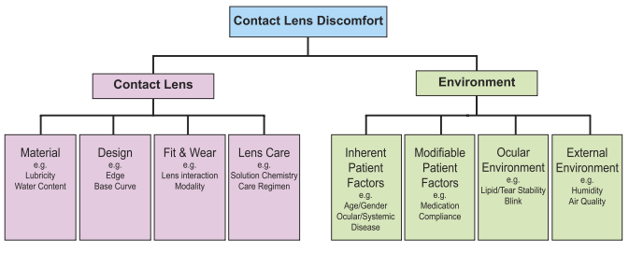
Factors to contact lens discomfort¹
1. Nichols KK, Redfern RL, Jacob JT, Nelson JD, Fonn D, Forstot SL, Huang JF, Holden BA, Nichols JJ; members of the TFOS International Workshop on Contact Lens Discomfort. The TFOS International Workshop on Contact Lens Discomfort: report of the definition and classification subcommittee. Invest Ophthalmol Vis Sci. 2013 Oct 18;54(11):TFOS14-9.

Slide 10
Contact lenses and the meibomian glands¹
Studies show patients who had worn contact lenses for longer periods of time show about a two-fold greater meibomian gland dropout or alteration than those who wore them for shorter periods of time.
Higher modulus lenses show higher meibomian gland loss than those wearing lower modulus lenses.
Worse meibum quality, reduced secretion, meibomian gland plugging and presence of foam at the meibomian gland orifice are associated with contact lens discomfort and a proactive approach should be taken to manage MGD earlier.
1. Jones, L., Efron, N., Bandamwar, K., Barnett, M., Jacobs, D.S., Jalbert, I., Pult, H., Rhee, M.K., Sheardown, H., Shovlin, J.P. and Stahl, U., 2023. TFOS Lifestyle: impact of contact lenses on the ocular surface. The Ocular Surface.

Slide 11
How to manage the ocular surface in contact lens wearers?¹
Change in care solution and care system
Adjustment of replacement schedule
Change in lens design or material
Tear supplementation (lubrication drops)
Improvement of environment
Need to treat the cause
1. Markoulli, M. and Kolanu, S., 2017. Contact lens wear and dry eyes: challenges and solutions. Clinical optometry, pp.41-48.

Slide 12
Management of Dry Eye¹
A regime including lubricants, lid hygiene and heat applied to the eyes for the management of dry eye disease and related eye conditions.
Preservative free eye drops have shown greater effectiveness than preserved drops in decreasing inflammation on the ocular surface and increasing the antioxidant contents in tears of patients with DED.
1. Craig, J.P., Nelson, J.D., Azar, D.T., Belmonte, C., Bron, A.J., Chauhan, S.K., de Paiva, C.S., Gomes, J.A., Hammitt, K.M., Jones, L. and Nichols, J.J., 2017. TFOS DEWS II report executive summary. The ocular surface, 15(4), pp.802-812.

Slide 13
Recommend an Eye Care Regime to help reduce symptoms of Dry Eye Disease¹
HEAT
CLEANSE
HYDRATE
1. Craig et al. 2017. TFOS DEWS II report executive summary. The ocular surface, 15(4), pp.802-812

Slide 14
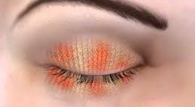
What is so important about HEAT?^{1,2}
HEAT
We want to increase the quality of the meibum…
Current thinking:
5 minutes* of heat @ 40ºC increases tear film lipid layer thickness by 80% in MGD patients¹
Remember to recommend gentle massaging to release the meibum
1. Olson Korb Greiner. Increase in tear film lipid layer thickness following treatment with warm compresses in patients with meibomian gland dysfunction. Eye Contact lens. 2003;29:96-99 DEWS II 2. Nichols, K.K., Foulks, G.N., Bron, A.J., Glasgow, B.J., Dogru, M., Tsubota, K., Lemp, M.A. and Sullivan, D.A., 2011. The international workshop on meibomian gland dysfunction: executive summary. Investigative ophthalmology & visual science, 52(4), pp.1922-1929.
Notes:
Current thinking
5 minutes of heat @40 degrees increases tear film lipid layer thickness by 80% in MGD patients
Olson Korb Greiner. Increase in tear film lipid layer thickness following treatment with warm compresses in patients with meibomian gland dysfunction. Eye Contact lens. 2003;29:96-99
DEWS II

Slide 15
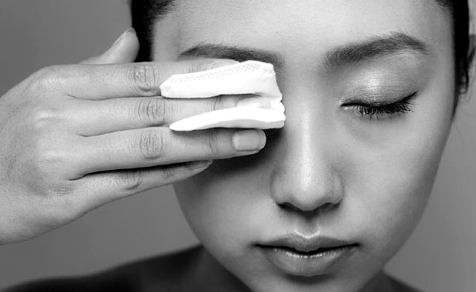
What is so important about CLEANSE?¹
It is important to make sure all the debris/dirt has been cleaned from eyelashes...
CLEANSE
Choose an option to suit the patient
Preservative free
1. Nichols, K.K., Foulks, G.N., Bron, A.J., Glasgow, B.J., Dogru, M., Tsubota, K., Lemp, M.A. and Sullivan, D.A., 2011. The international workshop on meibomian gland dysfunction: executive summary. Investigative ophthalmology & visual science, 52(4), pp.1922-1929.
Notes:
DEWS II

Slide 16
What is so important about HYDRATE?¹
Addition of hydration/lubrication is important to restore the homeostasis to the tear film...
HYDRATE
Preservative free
1. Nichols, K.K., Foulks, G.N., Bron, A.J., Glasgow, B.J., Dogru, M., Tsubota, K., Lemp, M.A. and Sullivan, D.A., 2011. The international workshop on meibomian gland dysfunction: executive summary. Investigative ophthalmology & visual science, 52(4), pp.1922-1929.
Notes:
DEWS II

Slide 17
QUESTIONS

