Slide 1
Blepharitis
subtitle

Slide 2
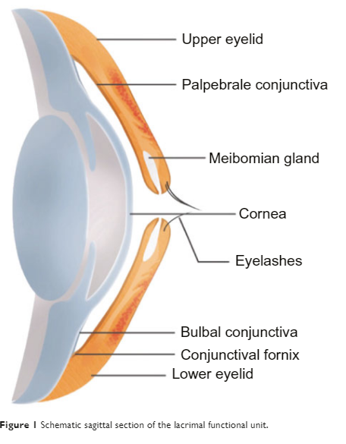
Let’s go to back to the beginning: Anterior eye
The cornea is the most fragile external structure of the body¹.
Healthy eyelid contains a lamellar structure with fine skin with conjunctiva on the inner surface¹.
Tear film forms a highly important layer between eyelid and surface of eye.
Eyelids protecting corneal surface
1. Benitez-del-Castillo, J.M., 2012. How to promote and preserve eyelid health. Clinical Ophthalmology, pp.1689-1698.

Slide 3
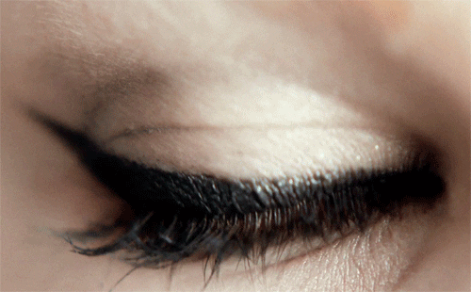
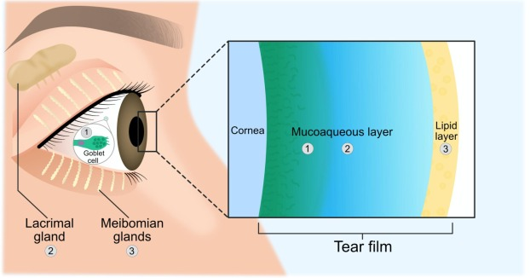
What’s behind the lids? The tear film¹
Older research suggests a three distinct layer tear film: lipid layer, aqueous layer, mucin layer.
New research now suggest two layers - the lipid layer overlying the mucoaqueous layer.
Adapted from Magno et al., 2022²
1. Nelson JD, Craig JP, EK Akpek, et al. TFOS DEWS II introduction. Ocul Surf. 2017;15(3):269-75.
2. Magno, M.S., Olafsson, J., Beining, M., Moschowits, E., Lagali, N., Wolffsohn, J.S., Craig, J.P., Vehof, J., Dartt, D.A. and Utheim, T.P., 2022. Hot towels: The bedrock of Meibomian gland dysfunction treatment–A review. Contact Lens and Anterior Eye, p.101775.

Slide 4
What is the function of the tear film?¹
Smooth surface for refraction of light
Lubrication of the ocular surface
Supplying the avascular cornea with nutrients
Removing foreign materials from the cornea and conjunctiva
Protecting the eye from pathogens
1. Rojas, B.R., OD (2023) Understanding the tear film. https://www.reviewofcontactlenses.com/article/understanding-the-tear-film

Slide 5
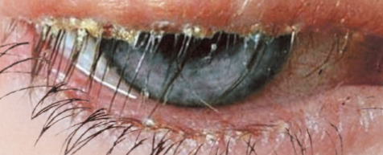
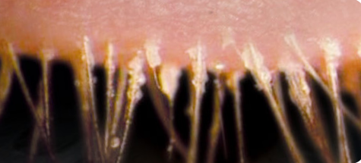
Blepharitis – what is it?¹
Blepharitis is characterised by an inflammation of the eyelid margins
Blepharitis is chronic; therefore, patients need to maintain good hygiene to prevent reoccurrences
It usually presents with recurrent symptoms that may vary over time and involve both eyes
1. Eberhardt, M. and Rammohan, G., 2017. Blepharitis.

Slide 6
Symptoms of blepharitis
Burning sensation
Soreness
Contact lens intolerance
Asymptomatic
Mild photophobia
Blurred vision
Ocular discomfort

Slide 7
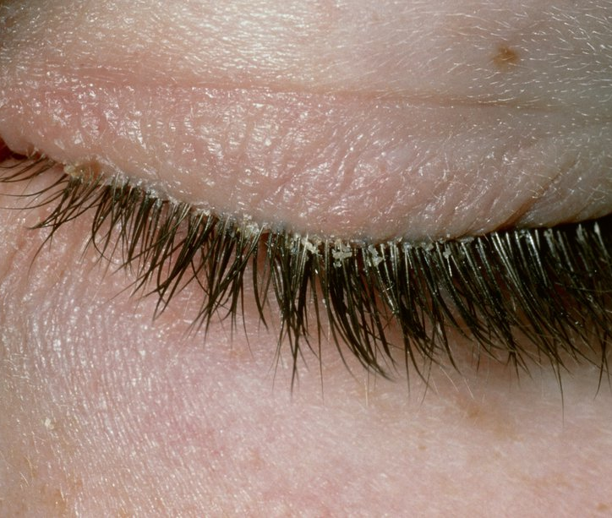
What are some of the signs of blepharitis?¹
Swollen eyelids
Inflamed lid margins
Scaling
Lash crusting
Irregularity/ulceration of the lid margins
Altered eyelash appearance (loss/misdirection)
Collarettes
Styes
Chalazion
1. Jackson, W.B., 2008. Blepharitis: current strategies for diagnosis and management. Canadian journal of ophthalmology, 43(2), pp.170-179.

Slide 8
Who gets blepharitis?
Blepharitis is not specific to any group of people¹
It affects people of all ages, ethnicities and gender.
It is more common in individuals older age 50.¹
It is extremely common worldwide and is probably the most common presentation in routine ophthalmologic practice.²
It is estimated that eyecare specialists see blepharitis in up to 47% of their patients.³
1. Eberhardt, M. and Rammohan, G., 2017. Blepharitis. 2. Jose M Benitez-del-Castillo (2012) How to promote and preserve eyelid health, Clinical Ophthalmology, , 1689-1698; 3. Tong, C.M. and Kurji, K., 2021. Blepharitis: Overview and Classification. Cornea, E-Book, 5, p.308.

Slide 9
Bacteria and blepharitis ¹⁻²
Bacteria survived on Earth for billions of year, by building a strong, impenetrable defence structure known as a biofilm¹
Biofilms are a system of microorganisms that can grow on different surfaces – one of those being our eyelids²
Biofilm helps bacteria to prevent desiccation¹
A surface usually must be wet or damp to allow biofilm growth²
Normal lid margin flora bacteria, gradually over-colonize the patients lid margin – over time becomes pathogenic ¹
1. Rynerson, J.M. and Perry, H.D., 2016. DEBS–a unification theory for dry eye and blepharitis. Clinical Ophthalmology, pp.2455-2467. 2. Baldwin, M. and Baldwin, M. (2022b) Biofilm & Dry Eye Symptoms | Wichita, KS. https://eyegalleryks.com/could-biofilm-be-the-source-of-your-dry-eye-symptoms/.

Slide 10
Causes of blepharitis¹
Seborrheic dermatitis
Ocular rosacea
Demodicosis
Demodex folliculorum is an ectoparasite that occurs normally in lash follicles.
Demodex brevis, is an ectoparasite, is found in meibomian glands.
Long-term contact lens wear
1. College of Optometrist 2024. Clinical Management Guidelines of Blepharitis (Lid margin disease). Available at: https://www.college-optometrists.org/clinical-guidance/clinical-management-guidelines/blepharitis_lidmargindisease Accessed on [June 2024]

Slide 11
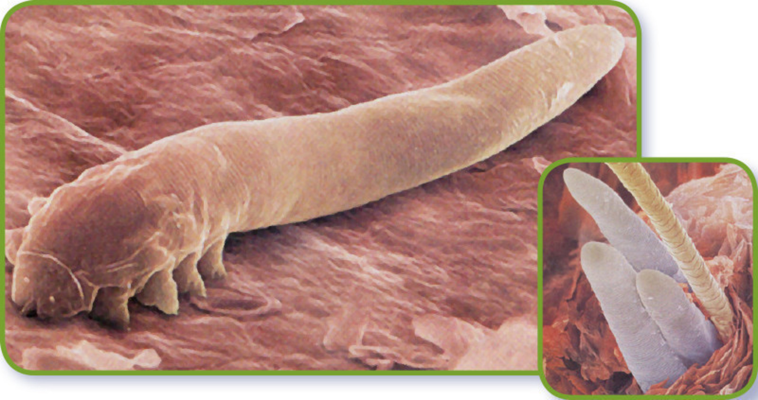
Demodex ¹⁻³
Ecto-parasites demodex folliculorum (DF) tend to live in the eyelash follicles and are associated with blepharitis, and demodex brevis (DB) tend to burrow into the meibomian glands and are associated with MGD.
The prevalence of the mites in patients younger than 20 years is between 13–20%, but in patients aged over 70 years it has a surprising prevalence of 100%.
Aim of treatment is to reduce the population of mites. General improvement in hygiene and body washing will help.
In patients who are felt to have significant Demodex infestations, tea tree oil eyelid scrubs have been shown to be beneficial when used for a minimum of 6 weeks.
1. Blackie, C.A., Solomon, J.D., Greiner, J.V., Holmes, M. and Korb, D.R., 2008. Inner eyelid surface temperature as a function of warm compress methodology. Optometry and Vision Science, 85(8), pp.675-683. 2. Farrant, Sarah. "Demodex--at the root of the problem." The Free Library 01 August 2014. Available at: https://www.thefreelibrary.com/Demodex--at the root of the problem.-a0381587925. Accessed [September 2022] 3. Eberhardt, M. and Rammohan, G., 2017. Blepharitis

Slide 12
Cataract surgery and blepharitis¹
Cataract surgery can worsen blepharitis during the postoperative period to result in increased ocular discomfort, and decreased vision and patient satisfaction.
Recovery of corneal nerve fibres takes about 8 months postoperatively.
Recovery of corneal sensation takes about 1-3 months.
Preservative-free disposable sterile eyelid wipes prevent blepharitis and MGD exacerbation after cataract surgery.
1. Eom, Y., Na, K.S., Hwang, H.S., Cho, K.J., Chung, T.Y., Jun, R.M., Ko, B.Y., Chun, Y.S., Kim, H.S. and Song, J.S., 2020. Clinical efficacy of eyelid hygiene in blepharitis and meibomian gland dysfunction after cataract surgery: a randomized controlled pilot trial. Scientific reports, 10(1), pp.1-11.

Slide 13
How do we treat Blepharitis?¹
Moist warm compresses
Daily lid hygiene
Good Compliance
Variety of treatments – working with your eye care practitioner finding the one that works for you!
Some key things to remember:
Remove all eye makeup before bed
No sharing skincare products
No sharing facecloths or towels
Washing eyelids daily
Seek medical advice if worsening
1. College of Optometrist 2024. Clinical Management Guidelines of Blepharitis (Lid margin disease). Available at: https://www.college-optometrists.org/clinical-guidance/clinical-management-guidelines/blepharitis_lidmargindisease Accessed on [June 2024]

Slide 14
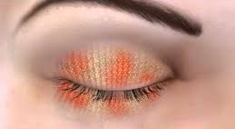
What is so important about HEAT?
HEAT
We want to soften the blepharitis on the eyelashes…
Current thinking:
5 minutes* of heat @ 40ºC increases tear film lipid layer thickness by 80% in MGD patients¹
Remember to recommend gentle massaging to release the meibum
1. Olson Korb Greiner. Increase in tear film lipid layer thickness following treatment with warm compresses in patients with meibomian gland dysfunction. Eye Contact lens. 2003;29:96-99 DEWS II

Slide 15
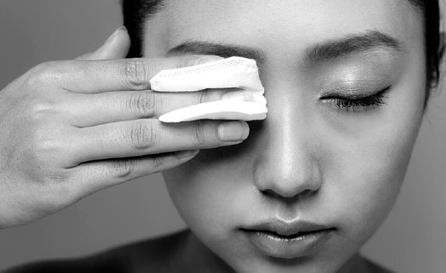
What is so important about CLEANSE?
It is important to make sure all the debris/dirt has been cleaned from eyelashes...
CLEANSE
Choose an option to suit the patient
Preservative free

Slide 16
What is so important about HYDRATE?
Addition of hydration/lubrication is important to restore the homeostasis to the tear film...
HYDRATE
Preservative free

Slide 17
QUESTIONS

